Slide 1

Method & Scope
Your success is our success
Funny Gorilla 诙猩猩
Notes:
Notes for title slide

Slide 2
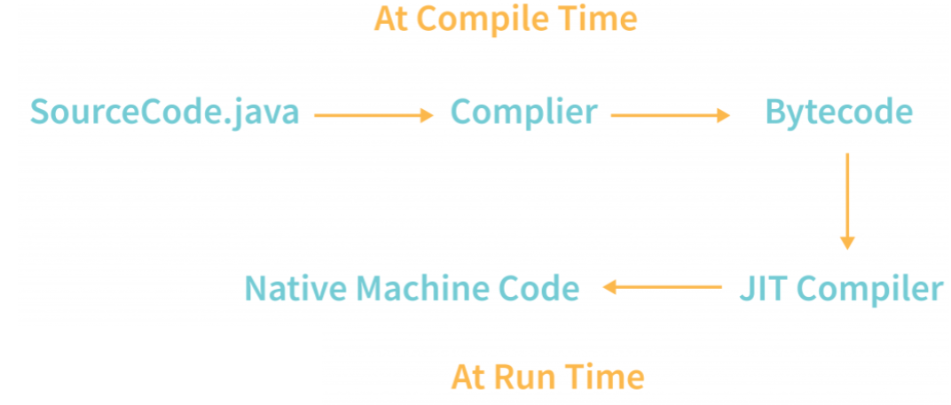
Java Code execution

Slide 3
Important Concepts
Object oriented programming (OOP)
Encapsulation
Inheritance
Composition
Polymorphism

Slide 4
Method

Slide 5
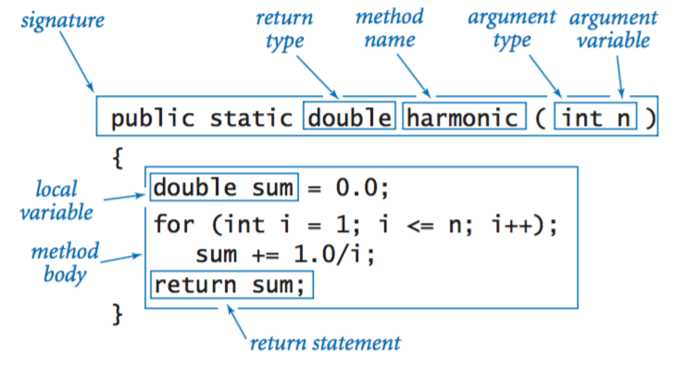
Static Method – Class Level

Slide 6
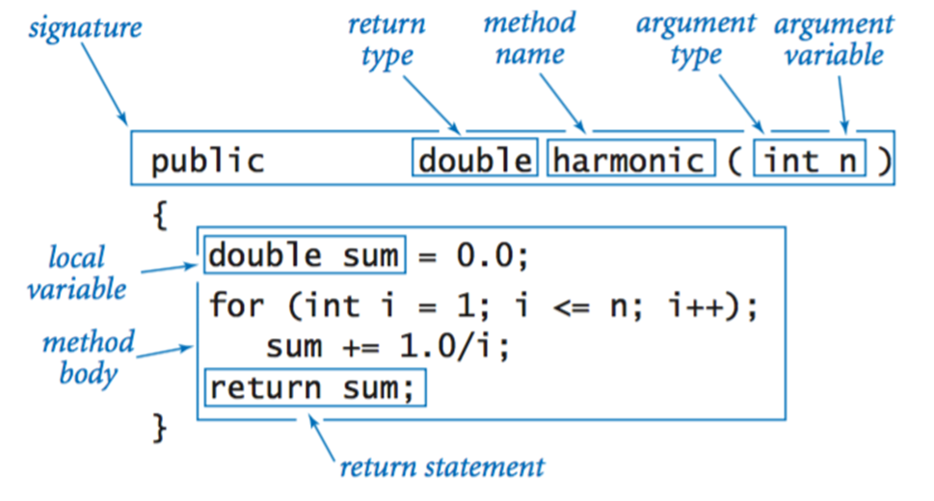
Instance Method

Slide 7
Variable Scope

Slide 8
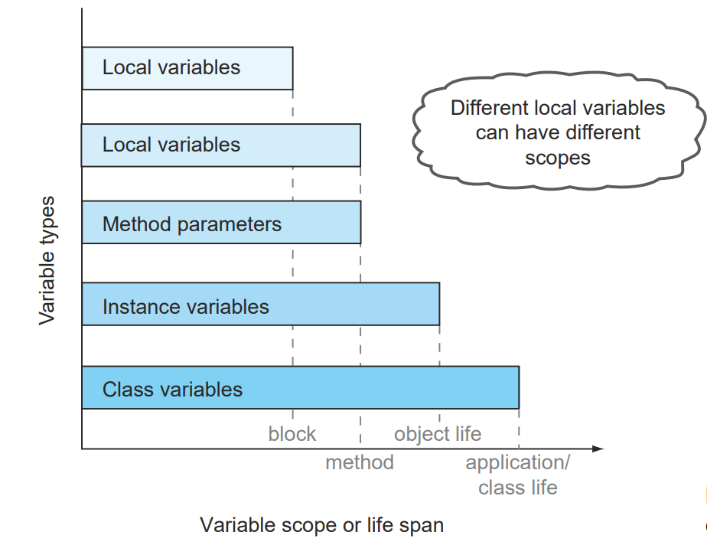

Slide 9
Reference
https://www.callicoder.com/java-arraylist/

Slide 10

Your success is our success
Contact
Mail: info@funnygorilla.com.au
Linkedin: https://mt.linkedin.com/in/songqing-gu-2ba9034b/de
Web Chat: FunnyGorilla
Phone: 0420891343

